Slide 1
Healthcare Faculty Scheduling: Predicting Staffing Preferences
Elizabeth Obst

Slide 2
Scheduling Challenge
Complexity
  Coordinating 53 faculty with 80+ CRNAs and 80+ residents
  Multiple operating rooms and shift types
Why It Matters
  Better staff matching improves patient outcomes
  Higher satisfaction and reduced burnout
Research Questions
  Staffing Type- Do faculty prefer CRNAs only, residents only, or mixed teams?
  Team Size- Do faculty prefer small (1-2), medium (3-4), or large (5+)?
  Specific Staff- Which individual CRNAs does each faculty prefer?
Notes:
For this study, the anesthesiology department faces a complex scheduling challenge - coordinating over 50 faculty members with more than 160 CRNAs and residents. Research shows that when faculty work with their preferred teams, it leads to better patient outcomes and reduced burnout. Given this, this study will focus on predicting faculty preference to optimize scheduling. My analysis addresses three questions: First, what staffing TYPE does each faculty prefer? Second, what TEAM SIZE do they typically use? And third, which SPECIFIC CRNAs does each faculty prefer to work with?

Slide 3
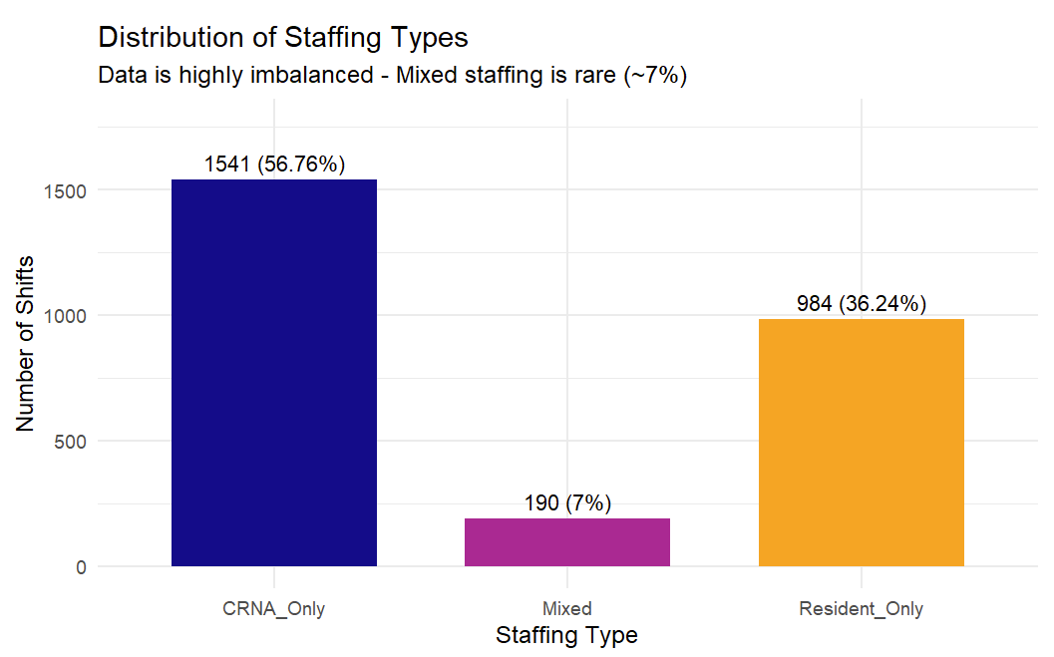
Data
Key Statistics
  2,924 shift records
  53 unique faculty
  160+ CRNA and Residents
  1 year of data (August 2024-August 2025)
Key Variables
  Temporal: Date, weekday, holiday, shift type
  Faculty: Experience, Team memberships, demographics
  Staffing: 80+ CRNA columns, 80+ Resident columns (binary True/False)
Key Challenge- Class Imbalance
  CRNA only: 57%
  Resident only: 36%
  Mixed: 7%
Notes:
I analyzed almost 3,000 shift records over one year, covering 53 faculty members and over 160 CRNAs and residents. The data includes temporal features like weekday and holidays, faculty characteristics like years of experience, and binary columns indicating which specific staff worked each shift. A major challenge is class imbalance - CRNA-only staffing represents 57% of shifts, while mixed staffing is only 7%. This imbalance significantly impacts our modeling approach.

Slide 4
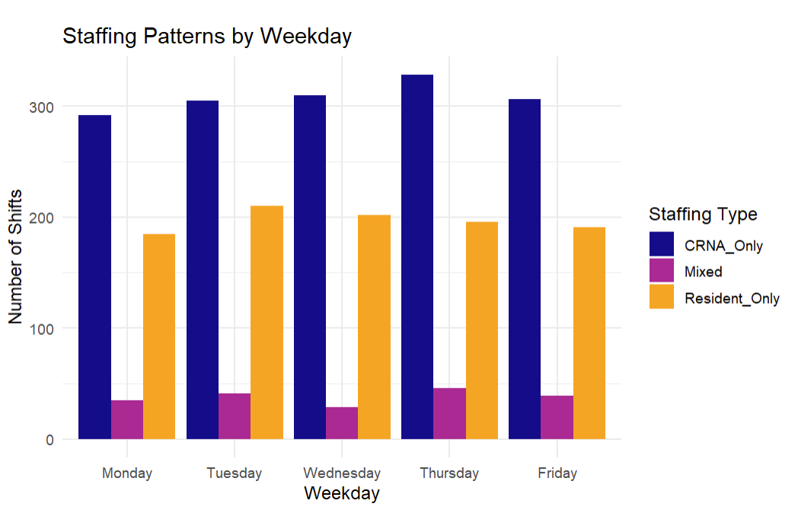
Exploratory Data Analysis
Faculty Preferences Vary Significantly
  FacultyQ: 100% CRNA only
  Faculty31: 81% Resident only
  FacultyE: 38% CRNA, 45% Resident, 17% Mixed
  Chi- square test: X² = 948, p < 0.001
Strong Room-Team Correlation
  R = 0.76, p < 0.001
  More rooms = larger teams
Weekday has no effect
  Chi-square: p = 0.779
  Staffing consistent Monday-Friday
Holidays have no effect
  T-test: p = 0.758
  Team sizes same on holidays vs regular days
Notes:
My exploratory analysis revealed several important patterns. First, faculty preferences vary dramatically - FacultyQ uses CRNA-only staffing 100% of the time, while Faculty31 prefers residents 81% of the time. A chi-square test confirmed these differences are highly significant. Second, there's a strong correlation between room count and team size - more active operating rooms means larger teams. Interestingly, weekday and holiday status have NO significant effect on staffing. This tells us that individual faculty preferences, not external temporal factors, drive scheduling decisions.

Slide 5
Feature Engineering
Created Target Variables:
  Staffing_Type: CRNA_Only, Mixed, Resident_Only
  Team_Size_Category: Small (1-2), Medium (3-4), Large (5+)
  CRNA Pairing: Binary indicator for each top CRNA
Temporal Features:
  WeekdayNum (1-7)
  Holiday indicator
  Shift duration (7-3 vs 7-5)
Key Predictors – Faculty Historical Features:
  Hist_CRNA_Only_Rate (% of shifts with CRNA only), Hist_Mixed_Rate, Hist_Resident_Only_Rate , Hist_Avg_Team_Size, Hist_Avg_CRNA, Hist_Avg_Resident
Availability Metrics:
  Avg_CRNA_Count, Avg_Res_Count, Avg_Room_Count
Data Split: 80% training (n=2,116), 20% test (n=530)
Notes:
For feature engineering, I created target variables for staffing type, team size categories, and binary indicators for each top CRNA. The most important features I engineered were faculty historical rates – these features calculated what percentage of each faculty's shifts used CRNA-only, mixed, or resident-only staffing. These historical patterns turned out to be the strongest predictors. I used an 80-20 train-test split for model evaluation.

Slide 6
Model 1 – Staffing Type Preferences
What Worked: All models beat baseline by 16+ percentage points
Limitation: Mixed class (only 7% of data) cannot be predicted - 0% sensitivity
Key Insight: All three methods found identical solutions - relationship is linear
Model Comparison Table:
Model | Accuracy | Kappa
Logistic Regression | 90.9% | 0.76
LDA | 90.9% | 0.76
SVM (Radial) | 90.9% | 0.76
Baseline | 74.3 | 0.00
Performance by Class:
Class | Sensitivity | Prevalence
CRNA_Only | 96.7% | 74%
Resident_Only | 84.2% | 23%
Mixed | 0% | 3%
Notes:
For predicting staffing type, I compared logistic regression, LDA, and SVM. All three achieved identical 91% accuracy - a 16-point improvement over baseline.The baseline being the no information rate from the confusion matrix. Looking at class-specific performance, we see excellent sensitivity for CRNA-only at 97% and resident-only at 84%. However, the Mixed class has 0% sensitivity - the models completely fail to predict it. This happens because Mixed represents only 7% of the data. The models learn to ignore this rare class and still achieve high accuracy. An interesting finding is that all three methods produced identical results, which tells us the underlying relationship is linear - no complex model needed.

Slide 7
Model 2 – Team Size Preferences
Key Findings:
  Models beat baseline by 21 percentage points
  Room count (r=0.76) strongly predicts team size
  Historical faculty patterns are strong predictors - Large teams too rare (<1%) to predict
Model Comparison Table:
Model | Accuracy | Kappa
Logistic Regression | 91.9% | 0.80
LDA | 91.9% | 0.80
SVM (Radial) | 91.9% | 0.80
Baseline | 70.8% | 0.00
Performance by Class:
Model | Sensitivity | Prevalence
Small (1-2) | 82.1% | 28%
Medium (3-4) | 96.8% | 71%
Large (5+) | 0% | <1%
Notes:
The team size model shows a similar pattern to the first model – this model achieved 92% accuracy across all three methods, beating baseline by 21 points. Small and medium teams are predicted well, but large teams are too rare to predict since they represent less than 1% of the data. The strong correlation between room count and team size helps this model perform well.

Slide 8
Model 3 – Specific CRNA Preference
The Challenge: Extreme Class Imbalance
  Each CRNA works with any given faculty only 4-6% of shifts
    A model predicting "no pairing" every time achieves 95%+ accuracy
What Made It Work:
  1. Class Weights - Penalize missing TRUE cases more heavily
  2. Random Split - Ensures all faculty in train & test sets
Initial Approach (Failed):
Model | Accuracy | Sensitivity
Logistic Regression | 95.3% | 0%
SVM | 95.3 | 0%
Baseline | 95.9 | 0%
Improved Approach (Success):
Model | Accuracy | Sensitivity
Ridge + Weights | 39.9% | 82.7%
SVM + Weights | 67.5% | 61.2%
Notes:
The CRNA pairing model was the most challenging. Each CRNA only works with any given faculty about 5% of the time, so a model that always predicts 'no pairing' gets 95% accuracy. My initial models actually performed WORSE than this baseline – they had high accuracy but zero sensitivity. To fix this, I made key changes: First, I used class weights to penalize the model more heavily for missing actual pairings. Secondd, I switched to a random split so all faculty appear in both training and test sets. The improved ridge regression model achieves 83% sensitivity - we now catch most actual pairings. The tradeoff to this higher sensitivity is lower accuracy at 40%, but for scheduling purposes, it's better to suggest potential matches than miss preferred relationships.

Slide 9
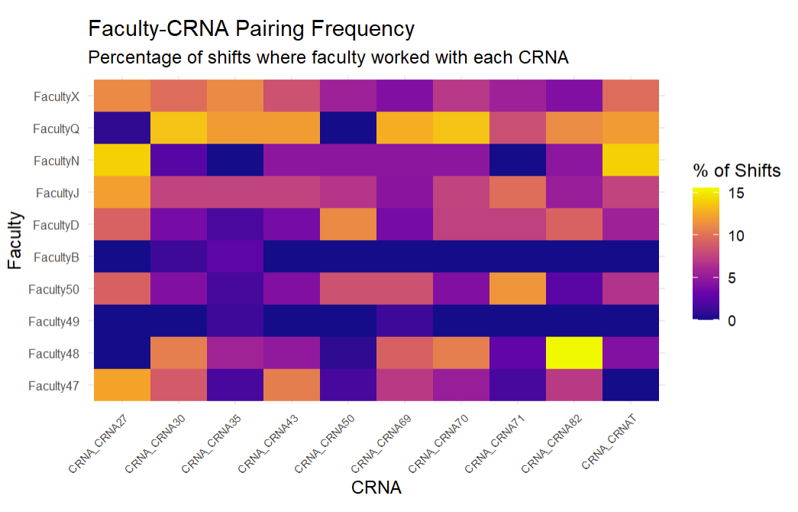
Model 3 – Example Predictions (CRNA27)
Predicted probability of working with CRNA_CRNA27:
Top 5 Predicted (High Probability):
Faculty | Actual % | Model Probability
FacultyN | 28.6% | 60.1%
FacultyD | 20.0% | 59.8%
FacultyX | 16.7% | 69.1%
Faculty47 | 14.3% | 72.6%
Faculty50 | 14.2% | 69.8%
Bottom 5 Predicted (Low Probability):
Faculty | Actual % | Model Probability
Faculty48 | 0% | 4.1%
Faculty37 | 0% | 3.2%
Faculty49 | 0% | 2.7%
FacultyB | 0% | 2.7%
FacultyQ | 0% | 19.1%
Notes:
Here is an example heatmap of the top 10 faculty and the top 10 scheduled CRNAs. The lighter yellow color represents the CRNA having a larger percentage of shifts with a specific Faculty and the darker purple color represents the CRNA having a smaller percentage of shifts with a specific Faculty. From this heatmap we can see CRNA27 is the most scheduled CRNA and appears to have more scheduled shifts with FacultyJ and Faculty50. CRNA27 appears to have the least shifts with Faculty48 and FacultyQ.
To demonstrate the model works, here are predictions for one CRNA. Faculty who actually work with this CRNA - like FacultyN with 29% actual rate - get high predicted probabilities. Faculty who never work with this CRNA get low probabilities, as low as 3%. The model is successfully ranking faculty by their likelihood of pairing. This works because faculty preferences for specific colleagues are intrinsic and stable - they don't depend on the day of the week or other external factors. Faculty identity directly encodes this preference.

Slide 10
Model 3 – Example Predictions
Faculty who actually work with this CRNA get higher probability scores
Faculty who never work with this CRNA get low scores
The model successfully ranks faculty by their likelihood of pairing
Faculty preferences for specific colleagues are intrinsic and stable - they don't change based on day of week or other external factors
Predicted probability of working with CRNA_CRNA27:
Top 5 Predicted (High Probability):
Faculty | Actual % | Model Probability
FacultyN | 28.6% | 60.1%
FacultyD | 20.0% | 59.8%
FacultyX | 16.7% | 69.1%
Faculty47 | 14.3% | 72.6%
Faculty50 | 14.2% | 69.8%
Bottom 5 Predicted (Low Probability):
Faculty | Actual % | Model Probability
Faculty48 | 0% | 4.1%
Faculty37 | 0% | 3.2%
Faculty49 | 0% | 2.7%
FacultyB | 0% | 2.7%
FacultyQ | 0% | 19.1%
Notes:
Here is an example heatmap of the top 10 faculty and the top 10 scheduled CRNAs. The lighter yellow color represents the CRNA having a larger percentage of shifts with a specific Faculty and the darker purple color represents the CRNA having a smaller percentage of shifts with a specific Faculty. From this heatmap we can see CRNA27 is the most scheduled CRNA and appears to have more scheduled shifts with FacultyJ and Faculty50. CRNA27 appears to have the least shifts with Faculty48 and FacultyQ.
To demonstrate the model works, here are predictions for one CRNA. Faculty who actually work with this CRNA - like FacultyN with 29% actual rate - get high predicted probabilities. Faculty who never work with this CRNA get low probabilities, as low as 3%. The model is successfully ranking faculty by their likelihood of pairing. This works because faculty preferences for specific colleagues are intrinsic and stable - they don't depend on the day of the week or other external factors. Faculty identity directly encodes this preference.

Slide 11
Conclusions and Recommendations
Key Successes:
  91% accuracy predicting staffing type
  92% accuracy predicting team size
  83% sensitivity for CRNA pairings
Limitations:
  Rare classes (Mixed, Large) cannot be predicted
  Some scheduling factors not captured in data
  Models may need retraining as staff changes
Key Insight:
  Faculty preferences are intrinsic. They don't depend on day of week, time, or other external factors.
Recommendations for Schedulers:
  1. Use historical preferences as primary guide
  2. Note that most faculty strongly prefer either CRNA-only or Resident-only teams; only 1 faculty regularly uses mixed staffing
  3. Consider prediction probabilities as suggestions to inform assignments
Notes:
In conclusion, I achieved 91-92% accuracy for staffing type and team size prediction, and 83% sensitivity for CRNA pairings after applying class weighting techniques. The key limitation is that rare classes like Mixed staffing can’t be predicted with only 7% of the data. The big insight from this analysis is that faculty preferences are intrinsic. They don't change based on weekday or other external factors. This is why historical patterns are our strongest predictors. For schedulers, I recommend using historical preferences as the primary guide, this will help predict which staffing type and team size each faculty member is likely to prefer on any given shift.
Faculty have strong, distinct preferences for staffing type - in fact, only one faculty member uses mixed staffing more than 20% of the time. This means most faculty clearly prefer either CRNAs or residents, and schedulers should respect these preferences to maintain good working relationships.,
and
While we can't predict exact pairings with certainty, the model successfully ranks which CRNAs are most likely to work well with each faculty member. This gives schedulers a starting point - instead of guessing, they can see that Faculty48 has a strong preference for CRNA82, or that FacultyQ works frequently with several specific CRNAs, and use that information to build better teams. Overall, implementing these recommendations will lead to better team cohesion, higher staff satisfaction, and ultimately better patient outcomes. Thank you for your time.

